Slide 1
RECEIPT AND INVOICE DIGITIZER
Milestone 3 – Dashboard & Reporting
TEAM - A
TEAM MEMBERS:
Abhay Maurya
Harini Kaveti Pattem Dharmika Vaibhavi Vernekar

Slide 2
Problem Statement :
Although invoice data was successfully extracted and stored in the database, critical gaps remained in data presentation and business insights.
No Centralized Dashboard
Users lacked a unified view to review uploaded bills and invoices
Missing Visualizations
Spending patterns and trends could not be visualized effectively.
No Monthly Summaries
Structured monthly spending summaries were unavailable for analysis.
Limited Reporting
Export functionality and structured reporting features did not exist.

Slide 3





Milestone 3 Objectives:
Interactive Dashboard
Build Stream lit dashboard for centralized data access.
Monthly Analytics
Implement spending analytics and trend calculations.
Export Features
Add CSV, Excel, and PDF export functionality.
Interactive Dashboard
Build Streamlit dashboard for centralized data access.
Vendor Insights
Create vendor and item-level business insights.
Clean UI
Provide responsive and user-friendly interface.

Slide 4

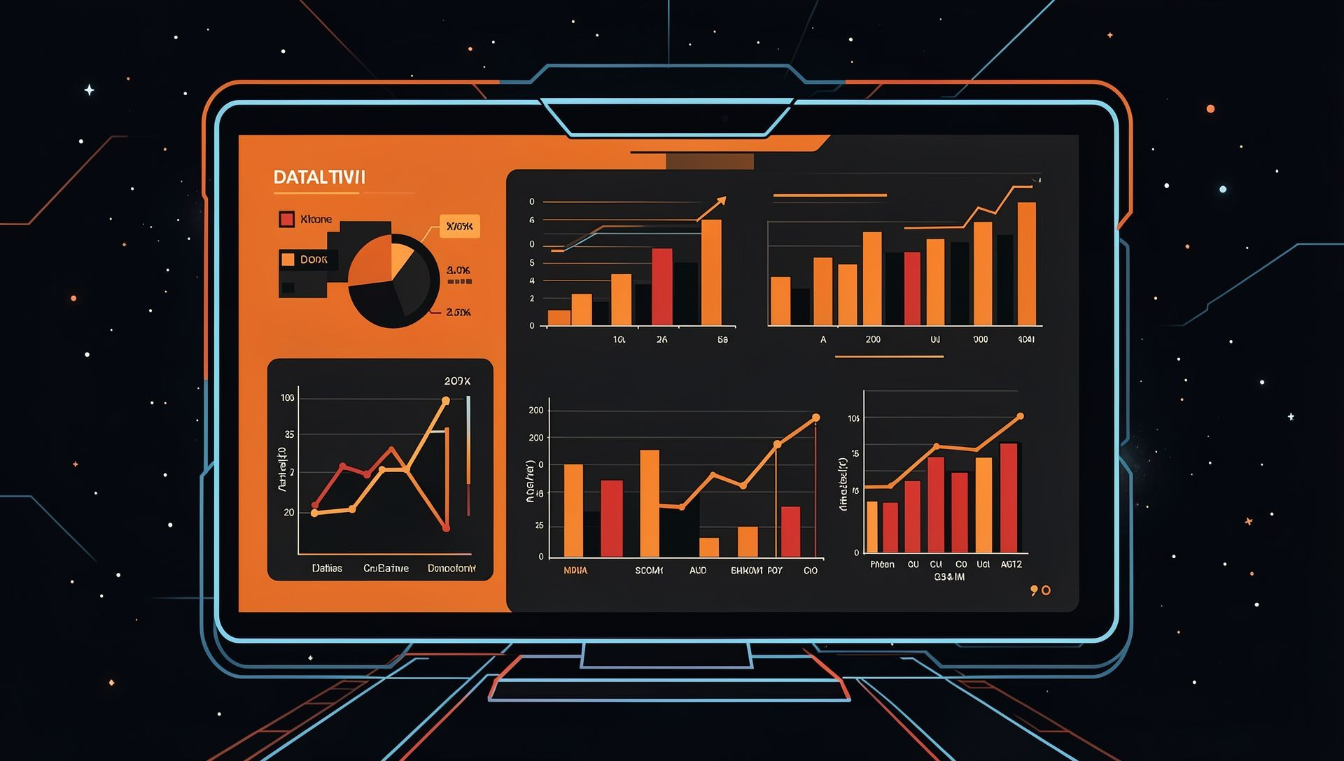
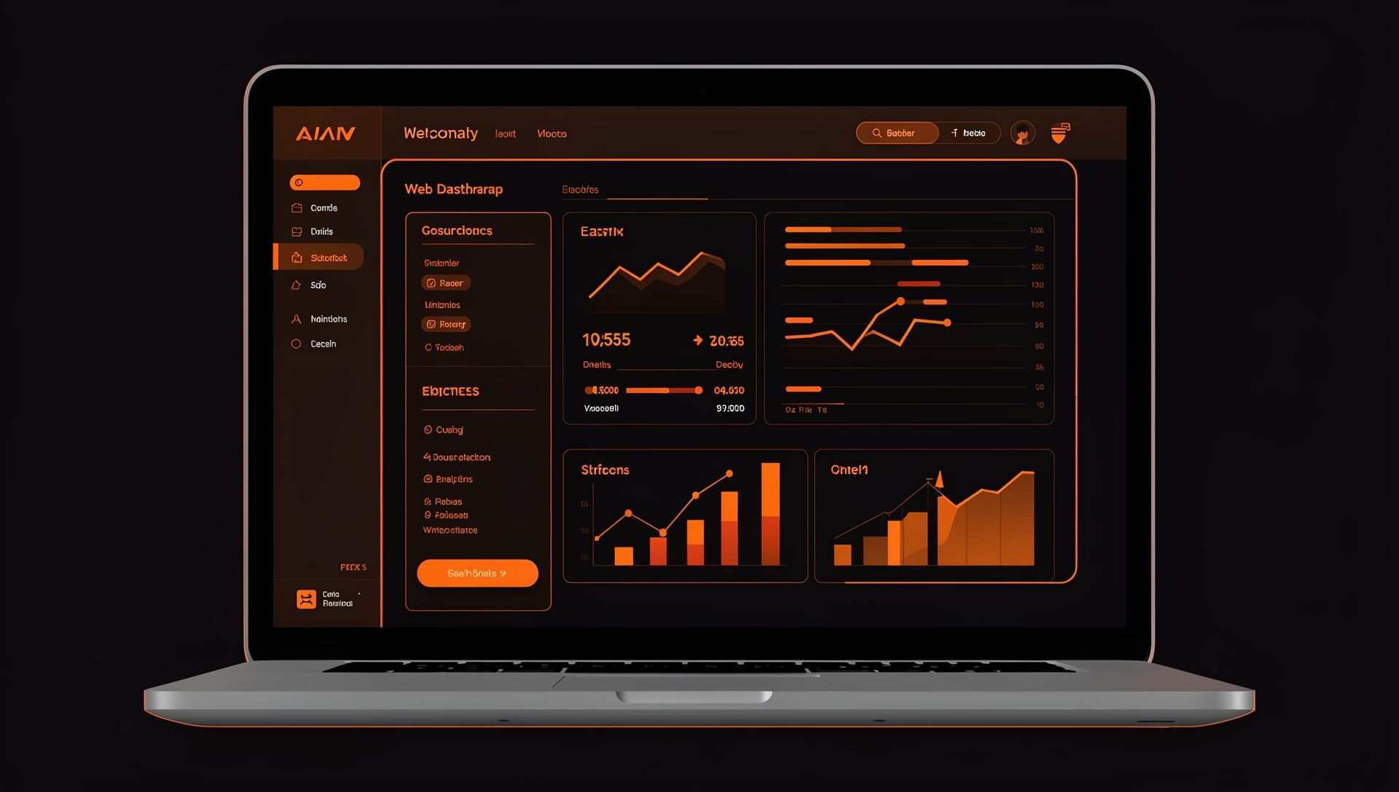

Team Roles & Responsibilities:
Harini Kaveti Analytics Module
Designing analytics logic
Monthly spending calculations
Vendor and item statistics
Data aggregation and trends
Abhay Maurya Visualization Module
Designing and implementing charts
Creating Plotly visualizations
Ensuring clarity and readability
Vaibhavi Vernekar Dashboard & UI
Structuring dashboard layout
Implementing filters
Ensuring responsive UI
Pattem Dharmika Reporting & Export
Implementing CSV/Excel/PDF exports
Structuring reports
Ensuring export accuracy

Slide 5
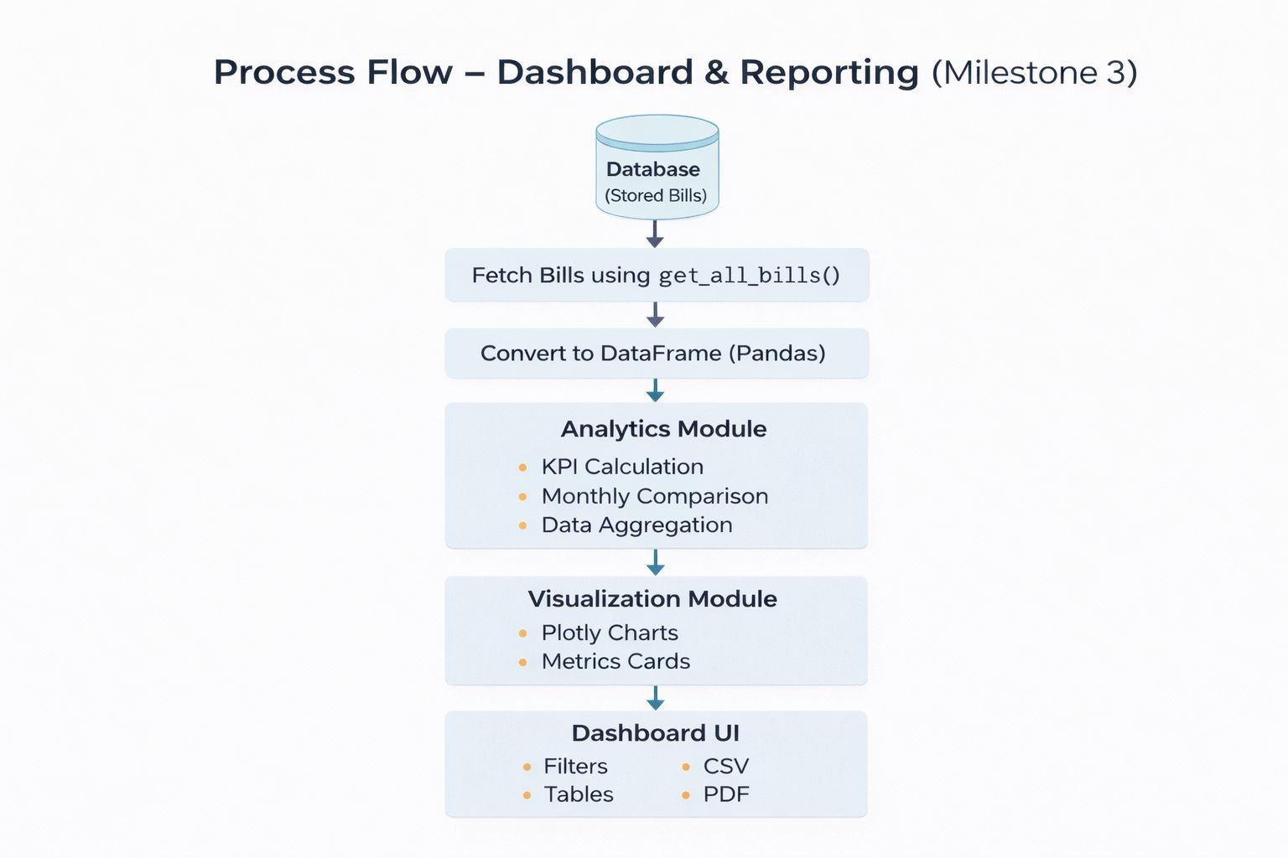
Process Flow:

Slide 6
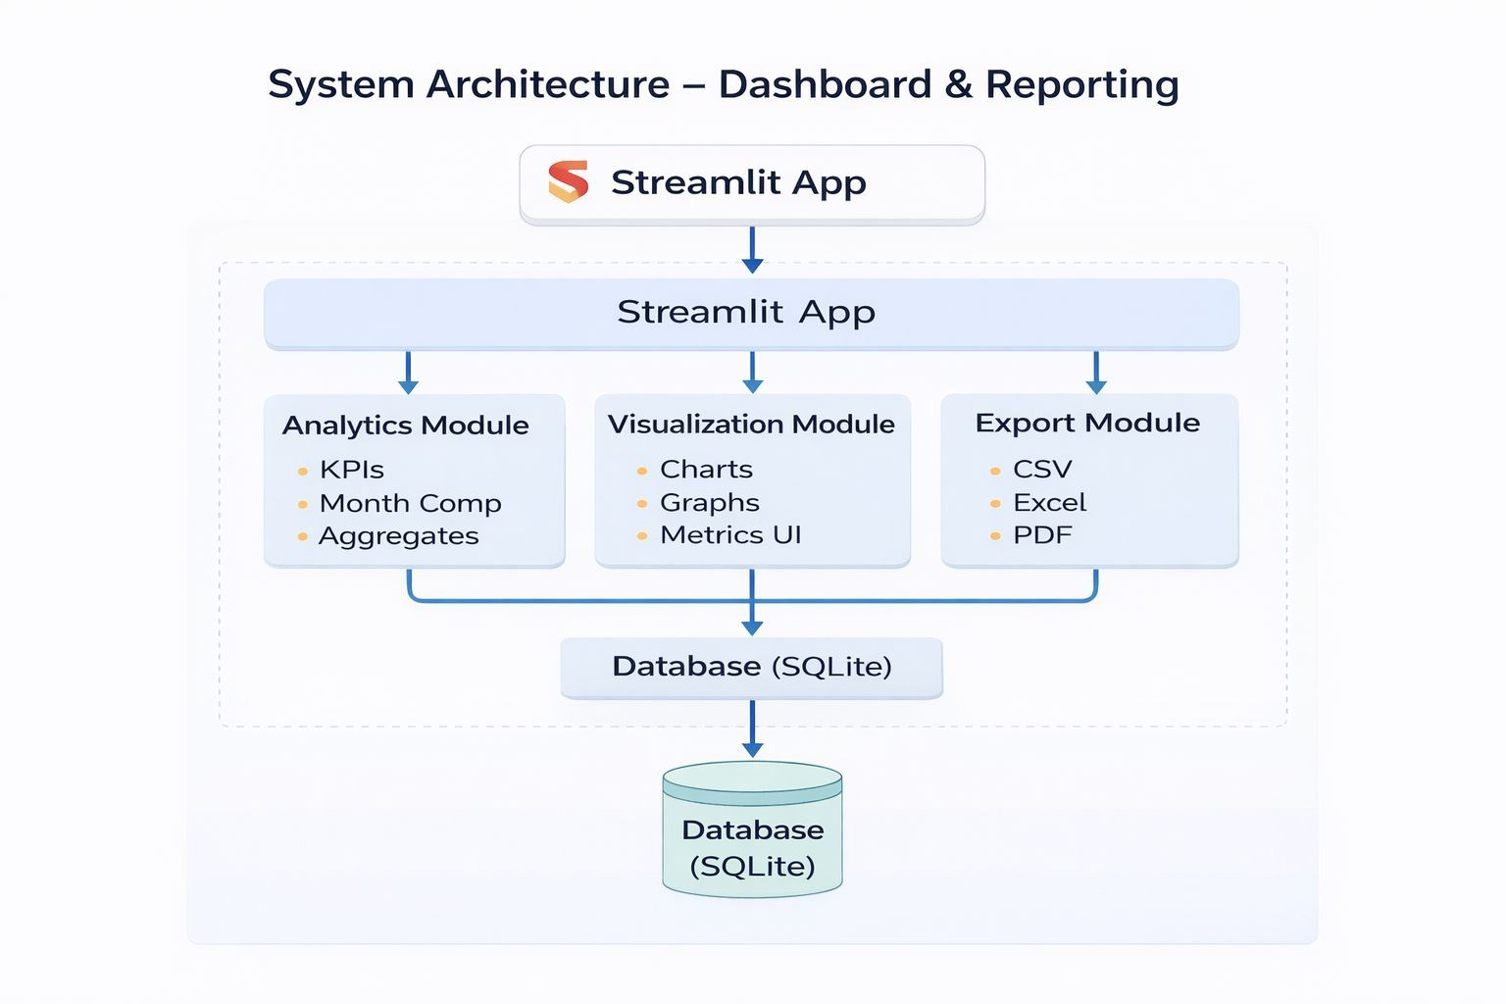
System Architecture:

Slide 7





Dashboard Features:
Key Metrics Display
Smart Filters
Monthly Trends
Essential spending indicators at a glance
Filter by date, vendor, amount, and payment method
Visualize spending patterns over time
Vendor Distribution
High-Value Detection
Understand vendor spending breakdown
Identify unusually large bills automatically

Slide 8
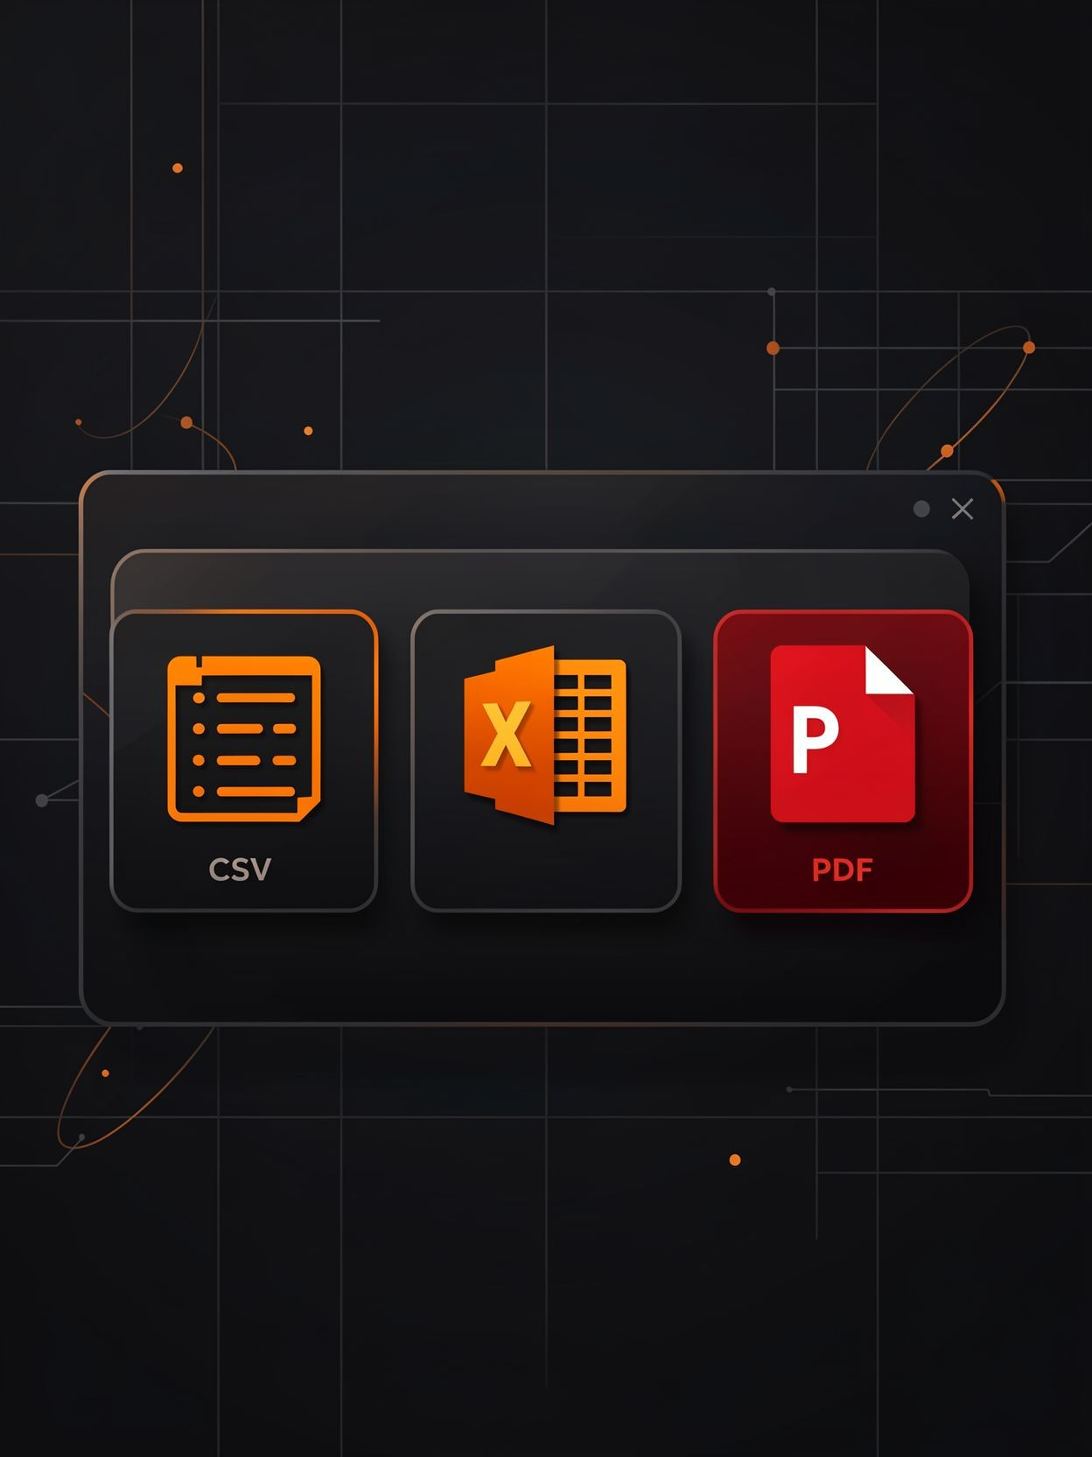
Reporting and Export:
Users can export data in multiple formats, making it easy to share insights with stakeholders and integrate with other systems.
Export Formats | Report Types
CSV format for spreadsheet analysis Excel format with structured data PDF format for professional sharing | Summary export with key metrics Detailed export including line items

Slide 9
Timeline: Weeks 5–6
Our development followed a structured two-week timeline, balancing planning with execution.
Week 5: Planning & Structure
Designed the dashboard layout and structure
Decided how data will be displayed (charts, tables, KPIs)
Created analytics logic for calculations
Defined data flow and processing steps
Week 6: Development & Testing
Implemented KPIs (Key Performance Indicators)
Added export functionality (Excel/CSV download)
Integrated frontend and backend components
Performed testing and fixed bugs
Final integration and validation

Slide 10
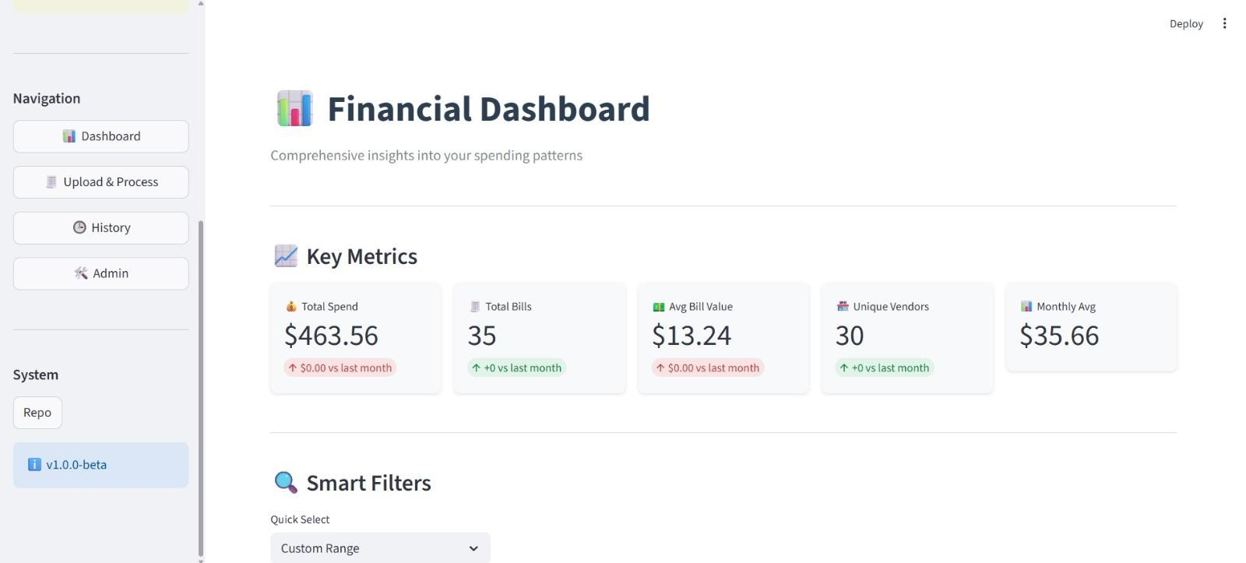
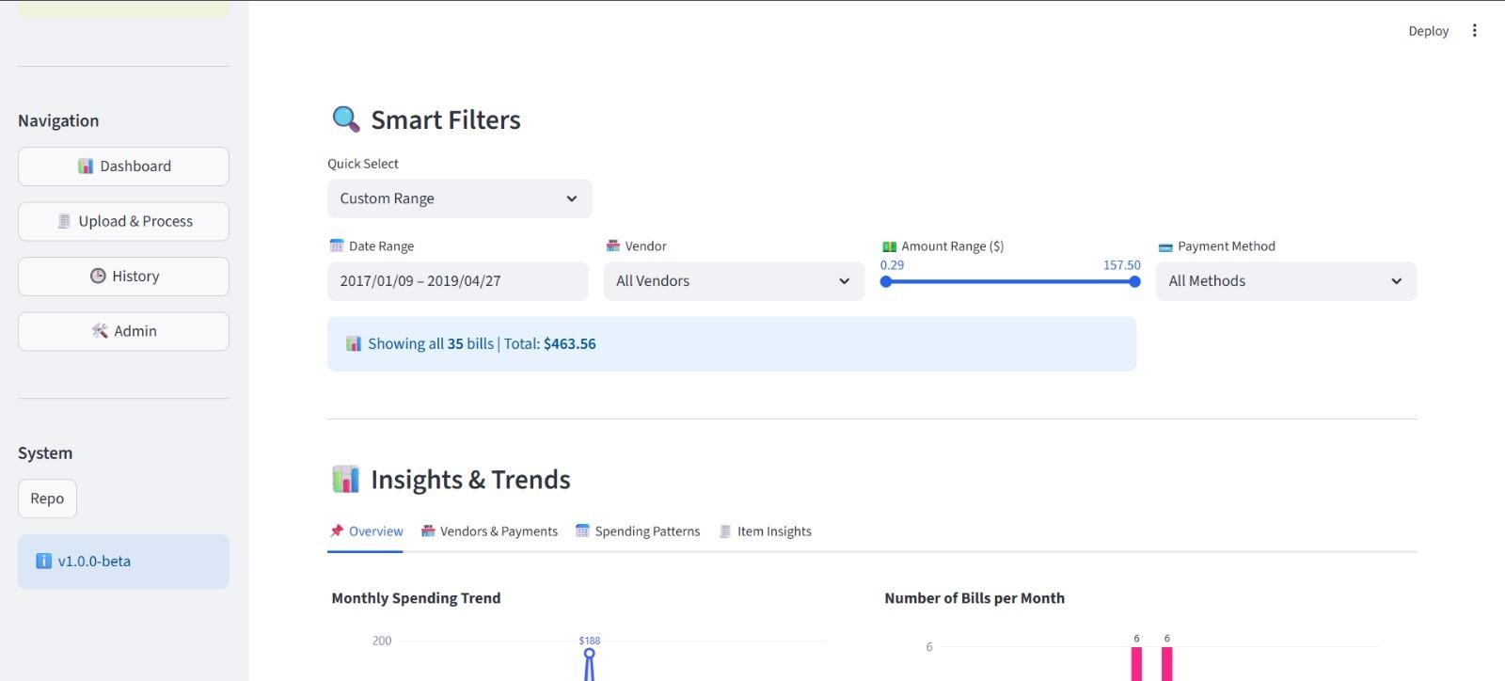
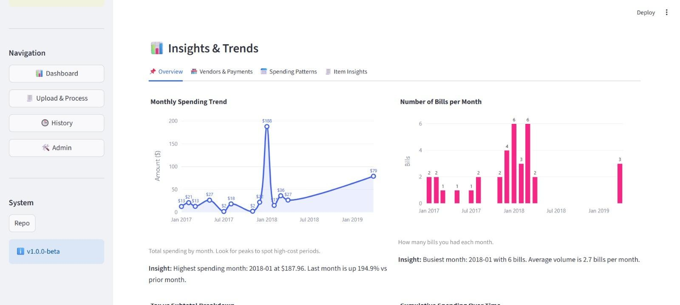
Final Output:

Slide 11
RECEIPT & INVOICE DIGITIZER
Milestone 4: Polishing & Integration
TEAM - A
Team Members:
Abhay Maurya
Vaibhavi Vernekar
Harini Kaveti
Pattem Dharmika

Slide 12
Problem Statement:
In the previous milestones, the system successfully implemented OCR extraction, data storage, and dashboard analytics. However, three key challenges remained:
Lack of system performance optimization
Inefficient resource utilization
Poor integration between modules
Data inconsistency across platforms
High latency in processing and response

Slide 13
Milestone 4: Objectives:
🔹 Template-Based Parsing
🔹 AI Insight Generation
🔹 Search & Filter System
🔹 Database Optimization & Query Performance

Slide 14
Team Roles & Responsibilities:
1. Pattem Dharmika - Template-Based Parsing
Responsible for improving vendor-specific extraction accuracy using deterministic templates.
2. Abhay Maurya - AI Insight Generation
Responsible for generating intelligent financial insights using Google Gemini AI.
3. Vaibhavi Vernekar - Search & Filter System
Responsible for implementing dynamic dashboard filtering and SQL-based filtering logic.
4. Harini Kaveti - Database Optimization & Query Performance
Responsible for improving query efficiency, reducing unnecessary data loading, and optimizing report generation.

Slide 15
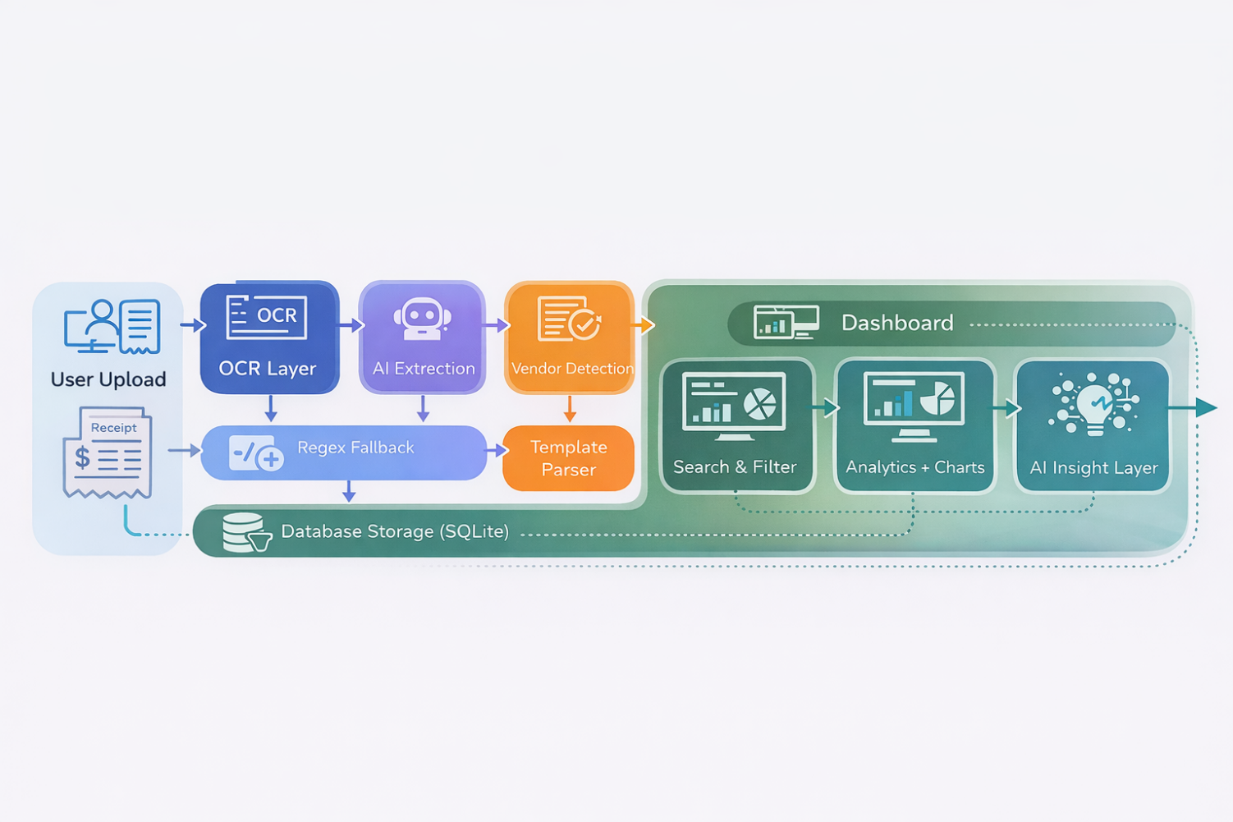
Process Flow:

Slide 16
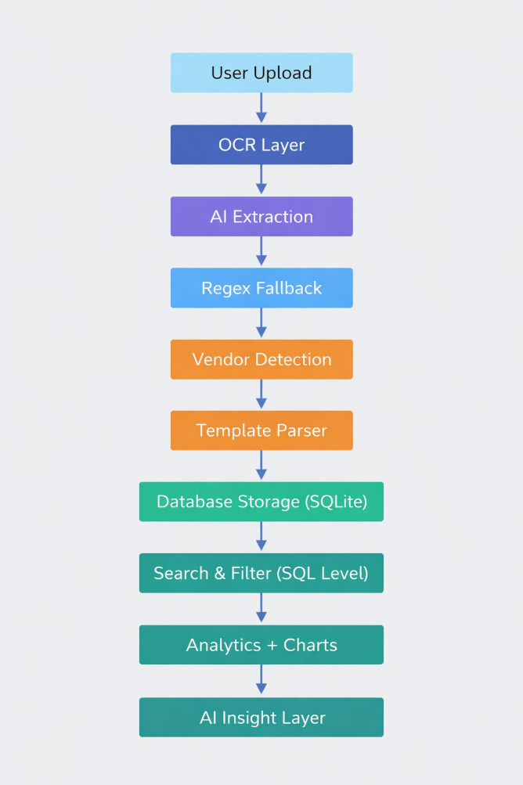
System Architecture:

Slide 17
Timeline: Weeks 7–8
Week 7: • Template parsing integration • SQL filter implementation • AI insight integration
Week 8: • Query optimization • Indexing • Performance testing • Final integration & review

Slide 18
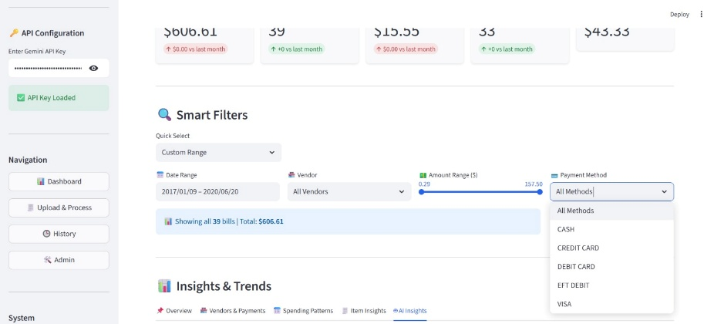
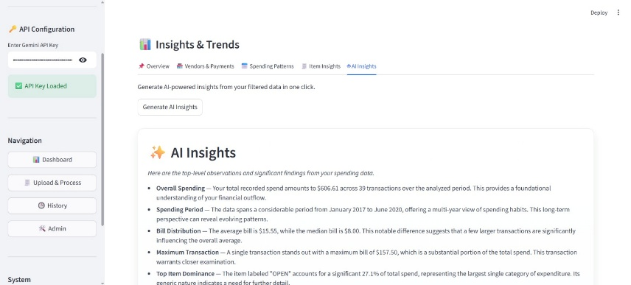
Final Output:
Polishing & Integration (Final Output)
• Improving extraction accuracy using vendor-based templates • Implementing SQL-based search and filter for better performance • Optimizing database queries and reports • Integrating AI-powered intelligent financial insights

Slide 19
Thank You

